Slide 1
Verb BE (ser o estar)

Slide 2
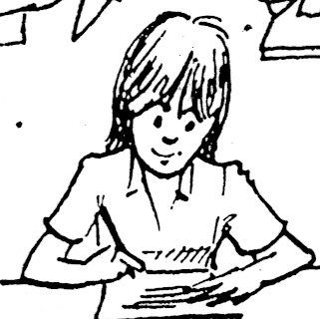
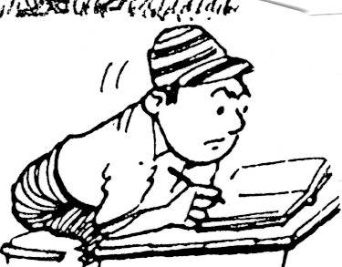
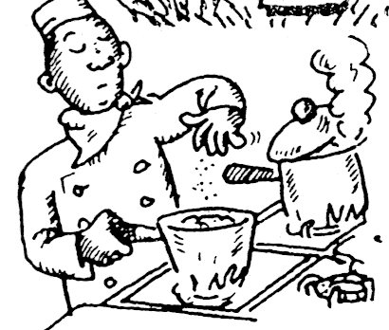
SINGULAR PRONOUNS:
I am = I’m – I am a student.
– I’m in class.
She is = she’s – She’s a good student.
– She’s at school.
He is = he’s – He’s an English student.
– He’s happy.
It is = it’s – It is a nice day.
– It’s a little hot.
You are = you’re – You’re a chef.
– You’re busy.
Verb BE is used in English according to the pronoun in singular.

Slide 3
SINGULAR PRONOUNS:
I am not = I’m not – I am not a student
– I’m not at school now.
She is not = she’s not or she isn’t
– She’s not a good student.
– She isn’t at school.
He is not = he’s not or he isn’t
– He’s not an English student.
– He isn’t happy.
It is not = it’s not or it isn’t
– It’s not a new cell phone.
– It isn’t hot today.
You aren’t = you’re not – You’re not a student.
– You aren’t here.
Verb BE - used in negative form:

Slide 4
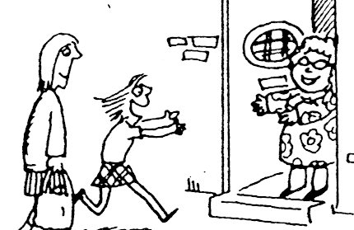
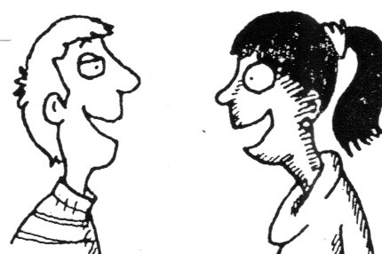
PLURAL PRONOUNS:
We are = we’re – we are new here.
– we’re happy here.
They are = they’re –They are here.
– They’re happy too.
You are = you’re – You’re students.
– You two are very happy.
Verb BE is used in English according to the pronoun in plural.

Slide 5
LENA _________ FROM ATENAS.
I _________ AN ENGLISH STUDENT.
MY FAMILY AND I _________ AT HOME.
THE COW _________ WHITE AND BLACK.
JOSUE AND ISAAC _________ STUDENTS.
THE TABLES _________ CLEAN.
TOM CRUISE _________ AN ACTOR.
THE PENCILCASE _________ ON THE DESK.
THE BOOKS _________ IN MY BACKPACK.
MONICA _________ VERY HAPPY TODAY.
Is
Am
Are
Is
Are
are
Is
Is
Are
Is
hhnhn
COMPLETE WITH: AM, IS , or ARE.

Slide 6
_________ HE YOUR FITNESS INSTRUCTOR?
_________ THEY YOUR SIBLINGS?
_________ ENRIQUE AN ACCOUNTANT?
_________ MRS. SMITH A LIBRARIAN?
_________ THE BANANAS FRESH?
_________ THE CHAIRS AROUND THE TABLE?
_________ THAT GIRL A CHEER LEADER?
_________ YOU A MATH TEACHER?
_________ I A POSITIVE PERSON?
_________ MR. AND MRS. RIOS MARRIED?
YES/NO QUESTIONS:
Is
Are
Is
Is
Are
Is
Is
Are
Is
Are
COMPLETE WITH THE CORRECT FORM OF BE

Slide 7
WHO_________ THAT MAN IN THE CAR?
WHEN_________ YOUR PARENTS AT HOME?
WHERE _________ OUR PETS NOW?
WHAT TIME _________ IT RIGHT NOW?
WHERE _________ MR. AND MRS. CLINTON?
HOW _________ YOUR GRANDPARENTS?
WHY _________ THE DENTIST ANGRY?
WHERE _________ YOUR WALLET, JOE?
WHO_________ THE TWO GIRLS OVER THERE?
WHAT _________ YOUR FAVORITE FOOD?
QUESTIONS WITH WH WORDS:
Is
are
Are
Is
Is
Are
Is
Is
are
Is
COMPLETE WITH THE CORRECT FORM OF BE

Slide 8
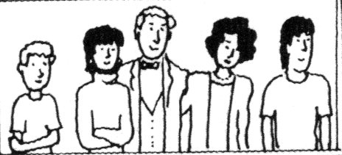
sister
dad
brother
me
mom
From left to right: This is me, my name is Joel. I am Joel. she is my sister Lucy, he is my father Carl, she is my mother Sue, and he’s my brother Mike.

Slide 9
TALK ABOUT THE MEMBERS OF YOUR FAMILY. SHOW A PHOTO AND MENTION THEM
HE’S …
SHE’S…
THEY’RE…

Slide 10
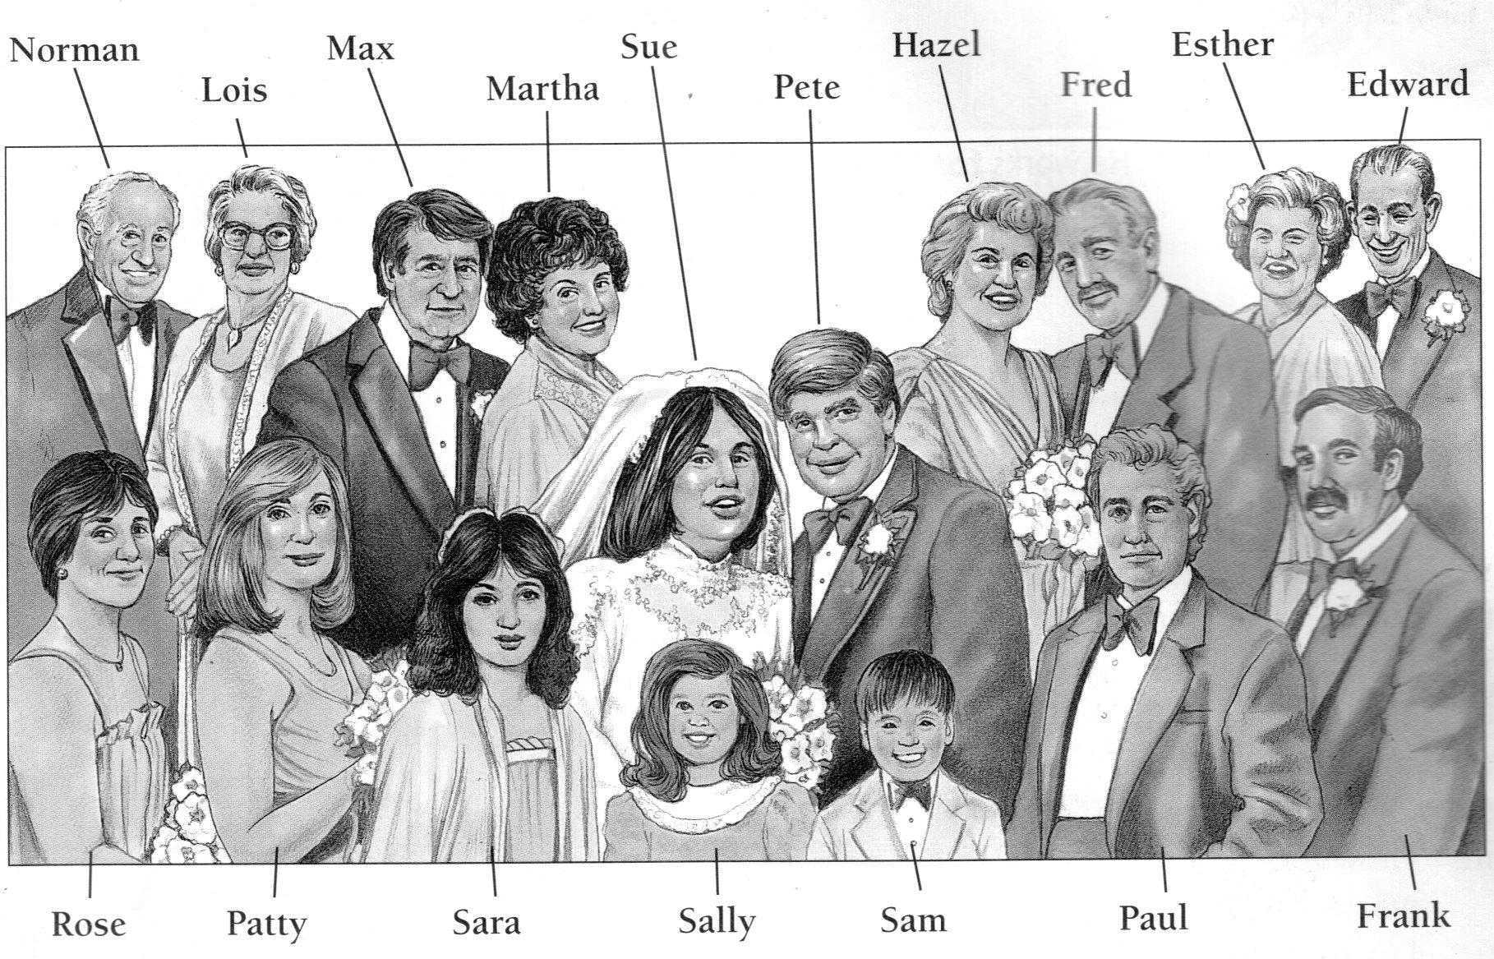
EXAMPLE

